Slide 1

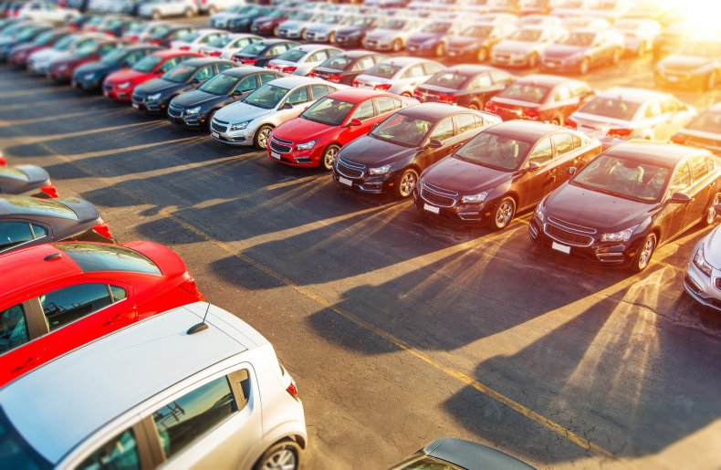
Used Cars Central

Slide 2

Presentation Overview
Team Introduction
Scope of the Project
Tech Stack
Demo
Future Enhancements

Slide 3



Meet Our Team
Revanth Posina
rposina@iu.edu
Syam Prajwal Kammula
skammul@iu.edu
Ram Kiran Devireddy
radevir@iu.edu

Slide 4
Scope of the Project
What is Used Cars Central?
Used car central is an online hub where sellers and buyers can come together to get the best deals.
Who can access the application?
Any user who is trying to sell his/her car or buy a used car can register on our website and access the car listings.
How can users access our application?
As it is a web-based application, the only things which a user needs are a modern world browser and an internet connection.
What can be seen on the application?
All available cars are listed here with the details of the car and owner. One can also find the list of cars he/she has listed to sell.

Slide 5

Tech Stack
Azure
Front End
HTML
Java Script
Back End
Flask using Python
Database
CSS
Microsoft SQL Server

Slide 6
Project Demo

Slide 7
Future Enhancements
Can integrate a payment feature in the application to ease the sale.
Can implement a chat functionality for better communication between the parties
Can update the frontend of the project to a more sophisticated framework for better security, appearance and process flow.
Can integrate a real time geo locator for more precise location of the vehicle so that the buyers can search for the vehicles with in the desired range.
Can implement criteria based search to get the results which match the specific user requirements.

Slide 8
Thank You !

